Slide 1

Understanding Azure Networking Services

Slide 2














Agenda
I
IV
II
?
Questions & Answers
III

Slide 3


Virtual Networks Point to Site VPN Site to Site VPN Express Route

Slide 4






Virtual Networks
Microsoft Azure
<subnet X> <subnet Y> <subnet Z>
DNS Server
Virtual Network

Slide 5
























VNet to VNet
Connectivity between Virtual Networks
Enables rich network topologies in the cloud
US East
Vnet A
US East Vnet B
Internet
US West Vnet A
US West Vnet B
US West Vnet C

Slide 6


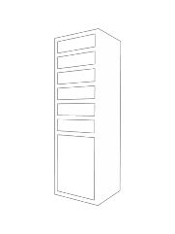





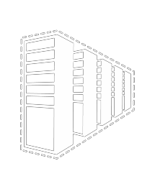










Hybrid Network Connectivity

Slide 7






















Point-to-Site VPNs
Azure
<subnet 1>
<subnet 2>
<subnet 3>
DNS
Server
On-premises
VPN
Gateway
Virtual Network
Route-based VPN
Point-to-Site
VPN
Your datacenter
Individual computers behind corporate firewall
Remote workers

Slide 8





Site-to-Site VPNs
Azure
<subnet 1>
<subnet 2>
<subnet 3>
DNS
Server
Site-to-Site VPN
On-premises
VPN
Gateway
Virtual Network
Route-based VPN
Your datacenter
Individual computers behind corporate firewall
Remote workers

Slide 9









Express Route
Site 3
Site
3
Site 1
Private Network
Site 2
Private Network
Site 1
Site 1
Greater networking costs and higher latency Data traverses the Internet to reach public cloud Limited bandwidth
Avoids risks from exposure to Internet Avoids complexity and added costs
Provides lower latency, higher bandwidth and greater availability

Slide 10


Load Balancing Traffic Manager

Slide 11
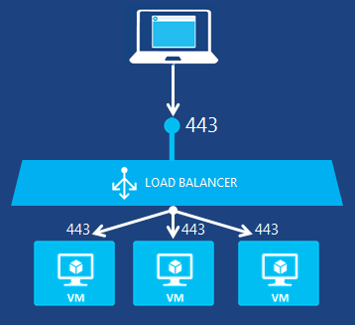
Azure Load Balancer
Layer-4 TCP and UDP Traffic Distribution
IaaS / PaaS Tenants
Multiple Endpoints
Service Monitoring
Source NAT

Slide 12
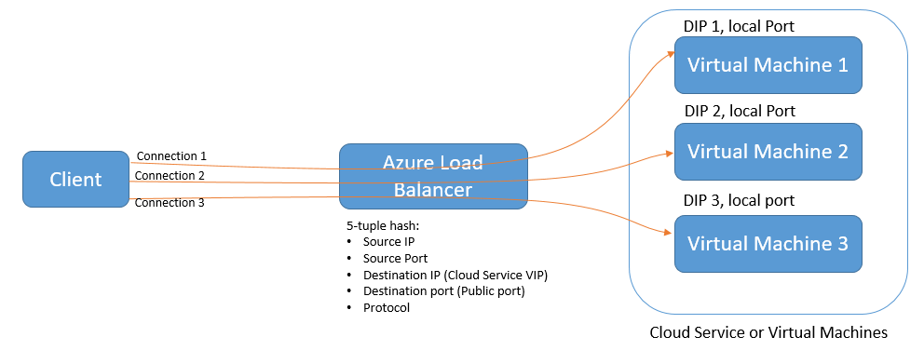
Distribution Mode - Hash

Slide 13
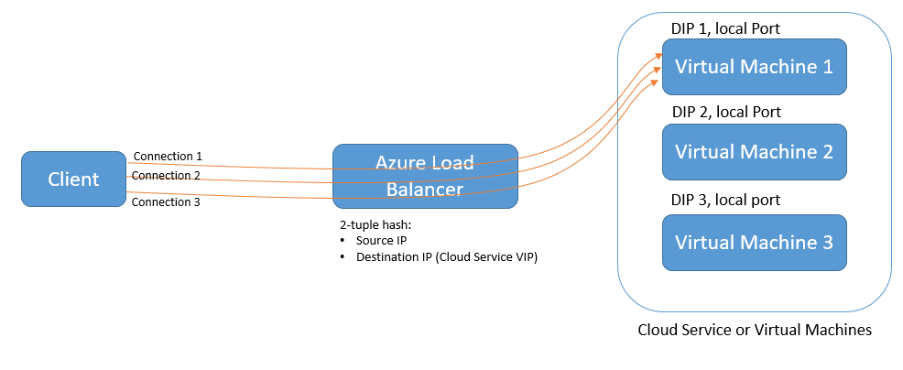
Distribution Mode – Source IP Affinity

Slide 14
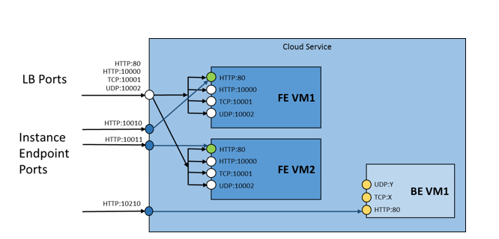
Example – Load Balancer Configuration
Load Balancers

Slide 15
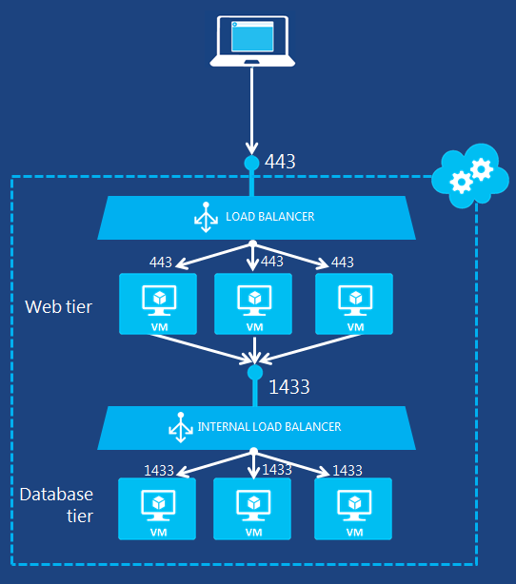
Internal Load Balancer
Internet Facing Multi-Tier Services with Cloud Services

Slide 16
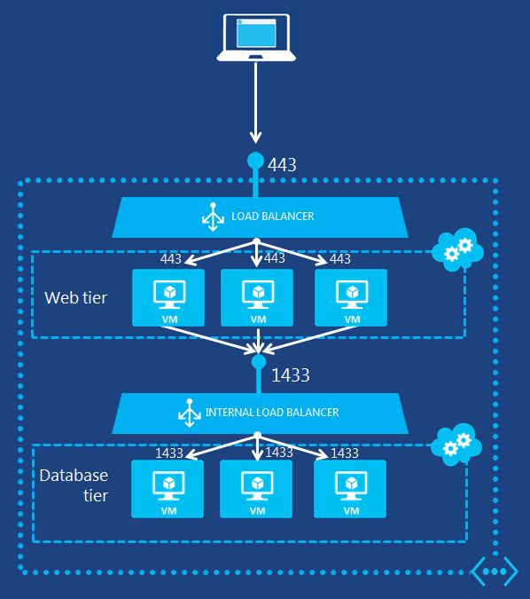
Internal Load Balancer
Multiple Cloud Services in a Virtual Network

Slide 17












Traffic Manager
www.contoso.com IN CNAME contoso.trafficmanager.net
User Traffic To Company
Domain Name
Company Domain Name To Traffic Manager Domain Name
Traffic Manager Domain Name & Profile
Traffic Manager Process Profile Rules
Endpoint Domain Name Sent To User
User Calls Endpoint
2
1
DNS
3
6
5
4

Slide 18






Traffic Manager – Failover
1
Endpoints | Status
1. CS-A | Offline
2. CS-B | Online
3. CS-C | Online
4. CS-D | Online
DNS
4
3
2 Check the ordered endpoints
Offline
CS-A
Primary
CS-B
Standby 1
CS-C
Standby 2
CS-D
Standby 3

Slide 19



Traffic Manager – Round Robin
Endpoints | Weights
CS-A | 2
CS-B | 2
CS-C | 5
CS-D | 1
1
DNS
4
3
2 Select CS-C (random, based on weight)
CS-A
CS-B
CS-C
CS-D

Slide 20





Traffic Manager – Performance
1
Maintain Internet Latency Table
Local DNS server
131.107.89.14
DNS
IP range | US West | US East | West Europe | East Asia
… | … | … | … | …
131.107.0.0/16 | 230 ms | 180 ms | 6 ms | 25 ms
… | … | … | … | …
2
6
5
3 Look up latency times
Cloud service | Datacenter
CS-A | East Asia
CS-B | West Europe
CS-C | US East
CS-D | US West
4
CS-A
CS-B
CS-C
CS-D

Slide 21

Virtual IP Address – VIP
Reserved Virtual IP Address - RVIP Static Internal IP Address – DIP
Public Instance IP Address – PIP

Slide 22





IP Addressing Overview
Virtual IP Address - VIP
Dynamic IP Address - DIP
foo.cloudapp.net → VIP

Slide 23
Reserved IP Address
Why
Constraints
foo.cloudapp.net → VIP

Slide 24
Static DIP Address
Why
foo.cloudapp.net → VIP

Slide 25





Instance Public IP Address
Why PIP
Constraints
foo.cloudapp.net → VIP

Slide 26

Network Endpoint ACLs Network Security Groups Multiple NICs

Slide 27

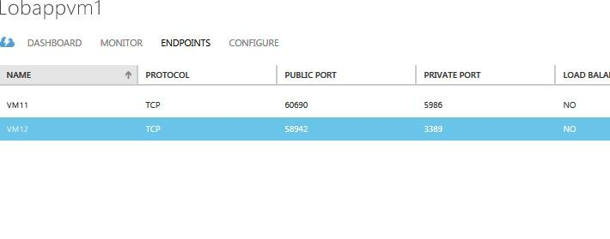








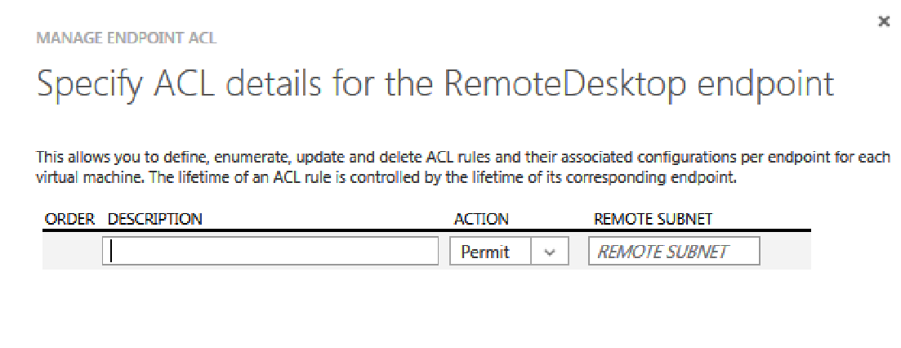




Network Endpoint ACLs
End Point ACL
IP: 127.255. ---.---
IP: 127.255. ---.---
IP: 111.111. ---.---
IP: 101. 121.---.255
IP: 101. 121.---.255
IP: 2001:4898:9:2:---
:e60c:b118:---
29

Slide 28
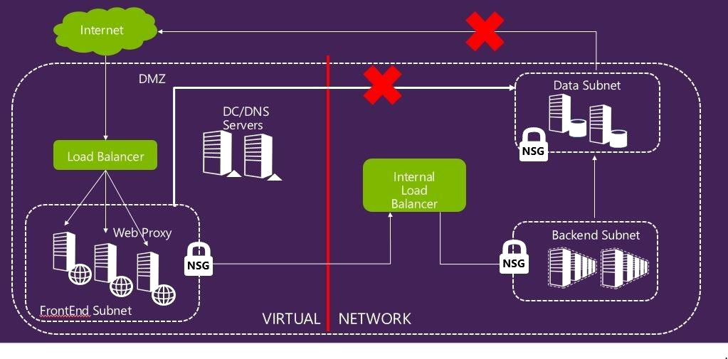
Network Security Groups
Name | Priority | Source IP | Source Port | Destination IP | Destination Port | Protocol | Access
WEB | 100 | INTERNET | * | * | 80 | TCP | ALLOW

Slide 29
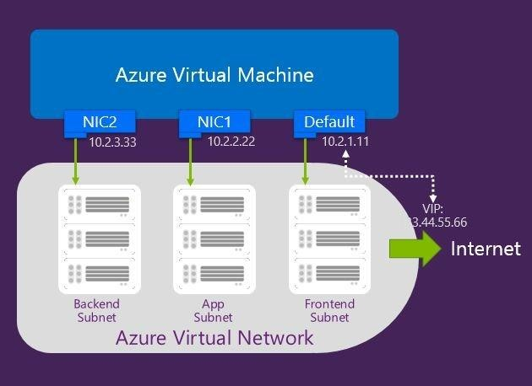
Multiple NICs
VM Size (Standard Tier) | Maximum NICs
A3, A6, D3, A8, G3, D12 (4-core VMs except G3-8, A8-8) | 2
A4, A7, A9, G4, D4, D13 (8-core VMs except G4-16, A9- 16) | 4
G5 (32-core), DS14 (16-core) | 8
All other sizes | 1

